Slide 1
FRST 232 Computer Applications in Forestry
Geographical Information System
GIS

Slide 2
Learning Objectives
Concept of GIS
Introduction
Learning objectives
What is GIS
Sources of input data
GIS Components
Attribute
GIS Data Types
- Raster vs Vector Data

Slide 3
What is GIS: Geographical Information System
Geographic and geospatial information formatting and analyzing in map forms.
Incorporates databases with spatial information in an integrated system.
Information of places on earth: what vs where. Also we need to specify when it happened.
“A computer-based system to aid in the collection, maintenance, storage, analysis, output, and distribution of spatial data and information” – Bolstad 2008

Slide 4
What Can be Done with GIS
Allows to visualize data on a map
Maps + Data =GIS

Slide 5
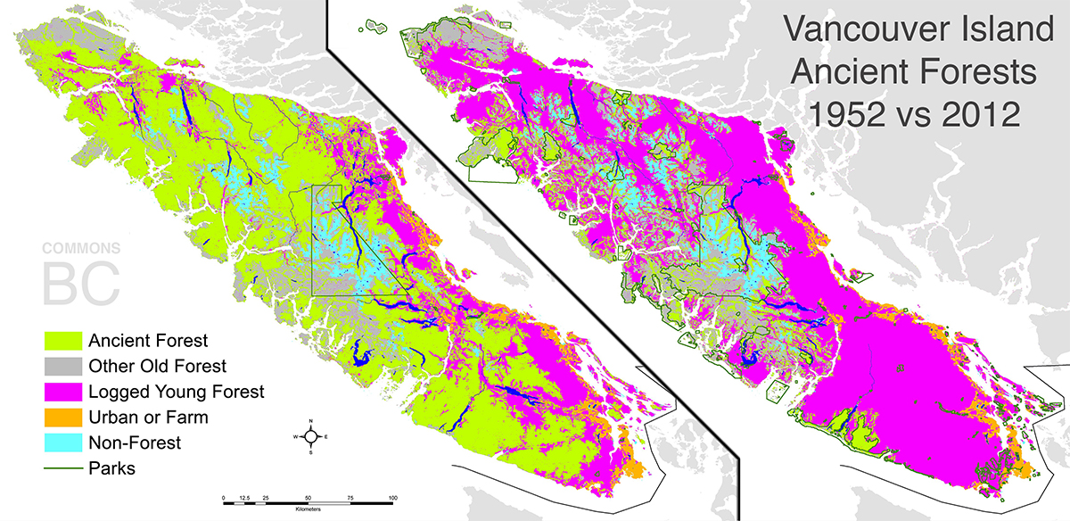
What Can be Done with GIS
Quickly answers queries of the data related to locations
Define objectives
Where things are happening
Changes over time
Identify where the most and least
Meeting criteria
Additional information beyond mapping
New decision/ policy based on changes
Image from: http://66.media.tumblr.com/8e921a3d68a6215cc4d87c03a67d4e96/tumblr_mmloctxAG61s7plxco1_1280.jpg

Slide 6
GIS Technologies: Sources of Input Data
GPS: Global Positioning Systems
A system of earth-orbiting satellites which can provide precise (100 meter to sub-cm.) location on the earth’s surface (in lat/long coordinates or equiv.)
RS: Remote Sensing
Use of satellites or aircraft to capture information about the earth’s surface. For example, in hydrology massively RS data is used: flood forecasting, reservoirs, irrigation scheduling etc.
GPS and RS are sources of input data for a Geographic Information Systems .A GIS provides for storing and manipulating GPS and RS data.

Slide 7
GIS Technologies: Sources of Input Data
RS integrated with GIS: Forest Inventory data
• Detailed forest inventory data (e.g., within-stand attributes)
• Broad area monitoring of forest health and natural disturbances
• Assessment of forest structure in support of sustainable forest management
Reference: http://cfs.nrcan.gc.ca/pubwarehouse/pdfs/25816.pdf

Slide 8
GIS Components
Most Important
Without data, nothing can be done
80% time in GIS projects is spent on database development
Persons of businesses that need the information, collect/process the data, create the hardware and software
Data
People
Hardware
Software
Procedures
The physical elements that make up a computer system
Eg. QGIS, ArcMap
Applications used by the computer to perform special functions
Methods used to produce correct reproducible results

Slide 9
Attributes
Record non-spatial characteristics
Also called Variables or items
Eg. Color, depth, tree height, age, DBH, vegetation type….

Slide 10
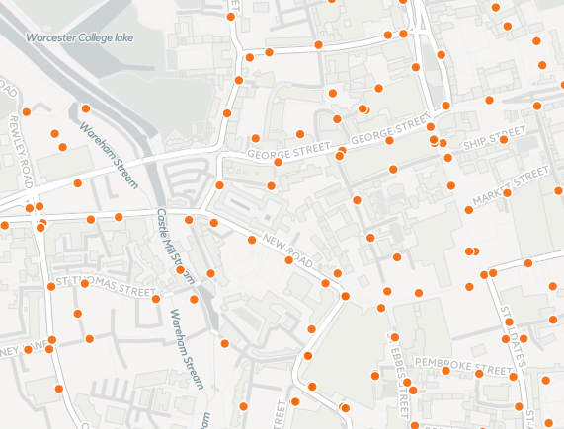
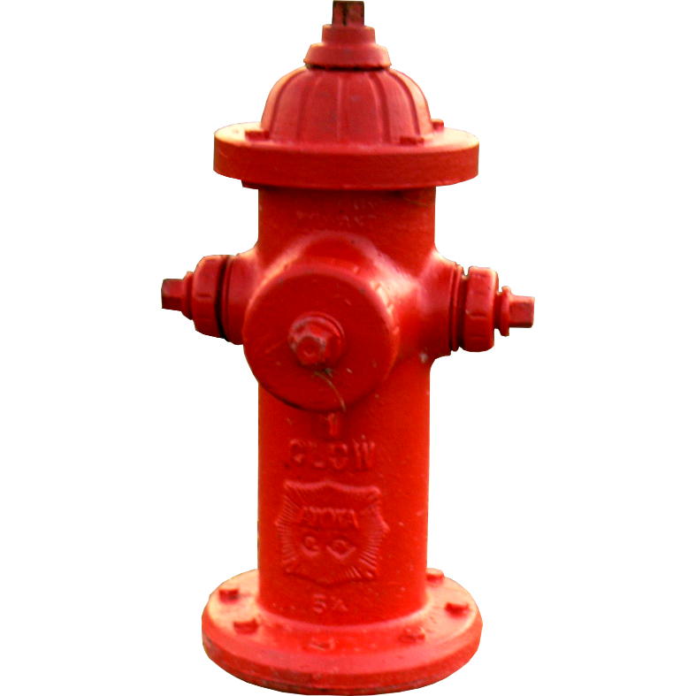
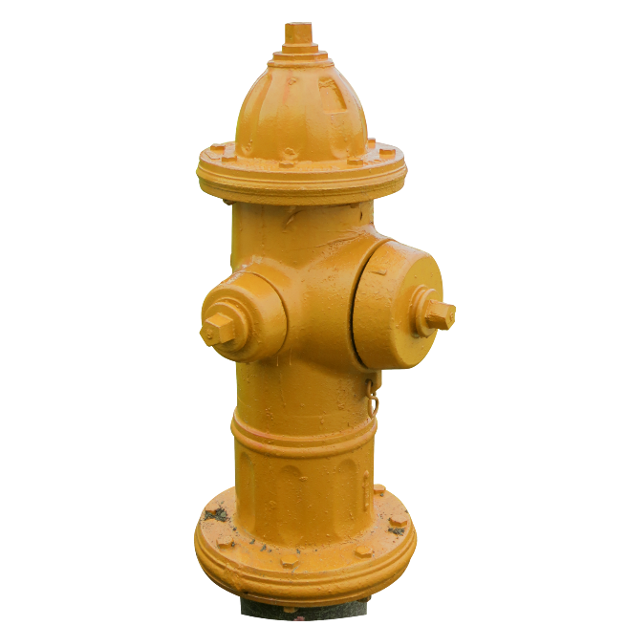
ID | Attachment number | Color | Usage
1 | 3 | Red | High
2 | 2 | Yellow | High
3 | 3 | Yellow | Low
4 | 2 | Red | High
… | … | … | …
Object
Spatial Data
Attribute data/table
Images From: http://immediateentourage.com/ie/wp-content/uploads/2010/12/Hydrant+by+qnr.png
http://img01.deviantart.net/b7d7/i/2013/250/e/0/fire_hydrant_png_file_by_lavitadistress-d6le4qk.png
https://shkspr.mobi/blog/wp-content/uploads/2015/09/Fire-Hydrants-Oxford.png
Images from: https://shkspr.mobi/blog/wp-content/uploads/2015/09/Fire-Hydrants-Oxford.png
http://www.immediateentourage.com/ie/wp-content/uploads/2010/12/Hydrant+by+qnr1.png
Notes:
post is required?where are parking lots, schools, churches, malls, or other suitable facilities located?

Slide 11
GIS Data Types
Raster data
Vector data

Slide 12
Raster Data
Values in the cells of grid
Define the world as a regular set of cells in a grid
Each cell represents a given area on the ground
Can manipulate the data in a cell individually or based on the attributes of neighboring cells

Slide 13
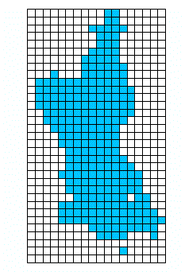
Images from:http://www.colorado.edu/geography/gcraft/notes/datacon/gif/raster.gif
http://farm3.static.flickr.com/2295/2199939046_f3bf66d23f_o.gif

Slide 14
Vector Data
Values stored in points, lines and polygon
Groups of coordinates are used to define objects
Image from: https://shkspr.mobi/blog/wp-content/uploads/2015/09/Fire-Hydrants-Oxford.png

Slide 15
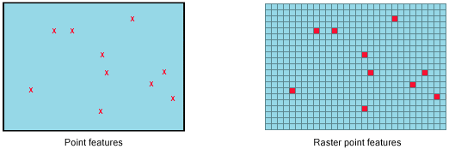
Point Data
Single pair of coordinates
Show location
Do not show dimension
Images from: http://desktop.arcgis.com/en/arcmap/10.3/manage-data/raster-and-images/GUID-50BB42BB-0E81-4D59-85FB-9F75F5D3069B-web.gif

Slide 16
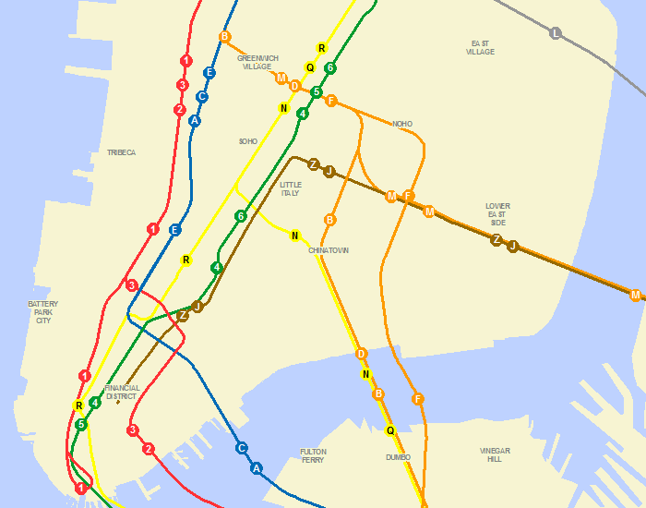
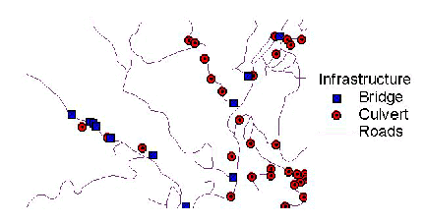
Lines
Ordered set of Coordinates
Starting/Ending points are called Nodes
Middle points are called Vertices
Also called arcs
Images from:https://sromalewski.files.wordpress.com/2010/07/gtfs_gis_lines.png
https://gislounge.com/wp-content/uploads/2000/05/points.png
Notes:
A culvert is a structure that allows water to flow under a road, railroad, trail, or similar obstruction from one side to the other side.
'Arc' is referring to the straight-line vectors between the nodes of a directed graph

Slide 17
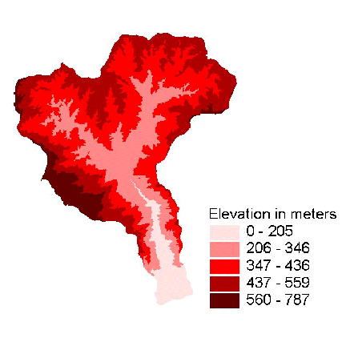
Polygons
Formed by a set of connecting lines
Have an interior region
Can have shared boundaries
Have an area

Slide 18
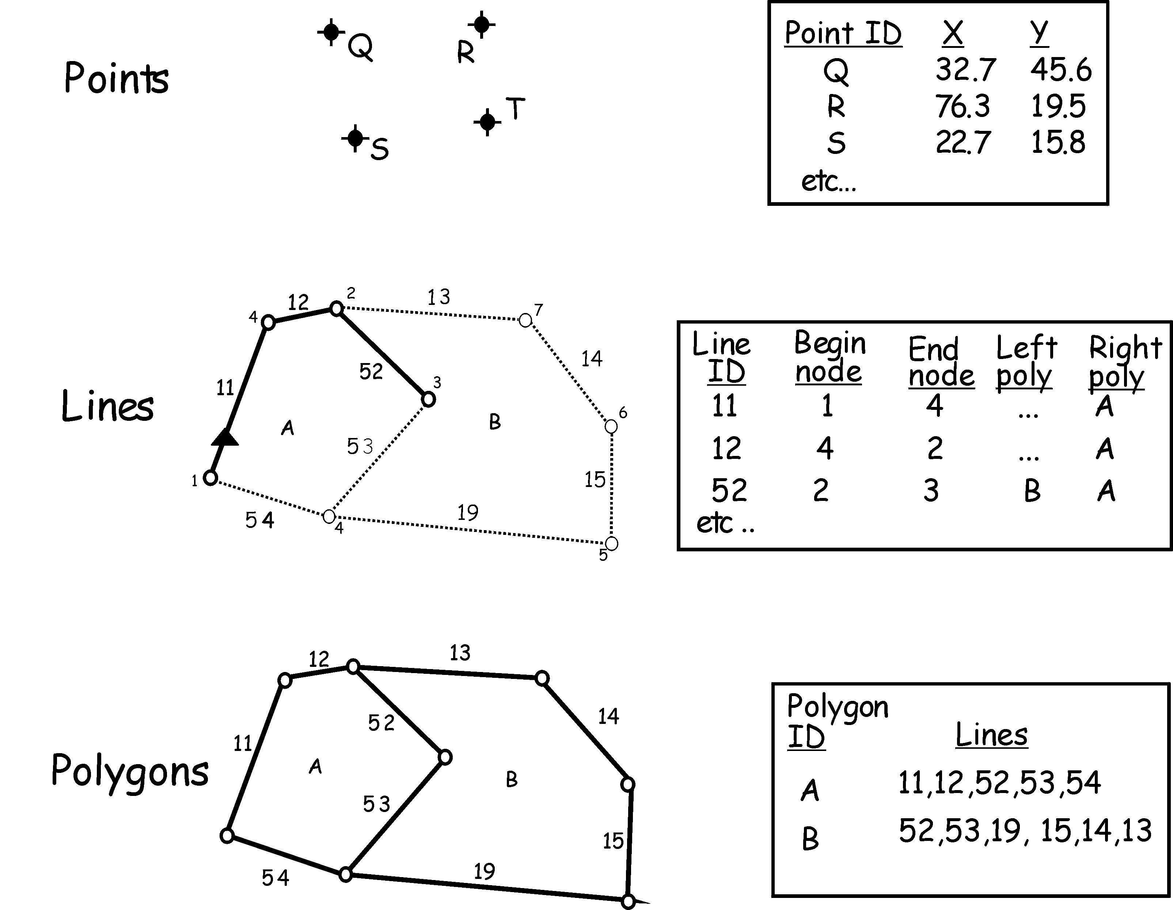
Points, Lines and Polygons

Slide 19
Summary
GIS: geographic information system
A tool for making and using spatial information
Without data, nothing can be done
Attributes record non-spatial characteristics (eg. Fire hydrant color, tree species)
Raster Data is stored and represented in a grid
Vector data uses groups of coordinates
Points, Lines and Polygons
Notes:
Latitudes and Longitudes in Vector data are displayed in the form of lines, points, etc.
Latitudes and Longitudes in Raster data are displayed in the form of closed shapes where each pixel has a particular latitude and longitude associated with it.

Slide 20
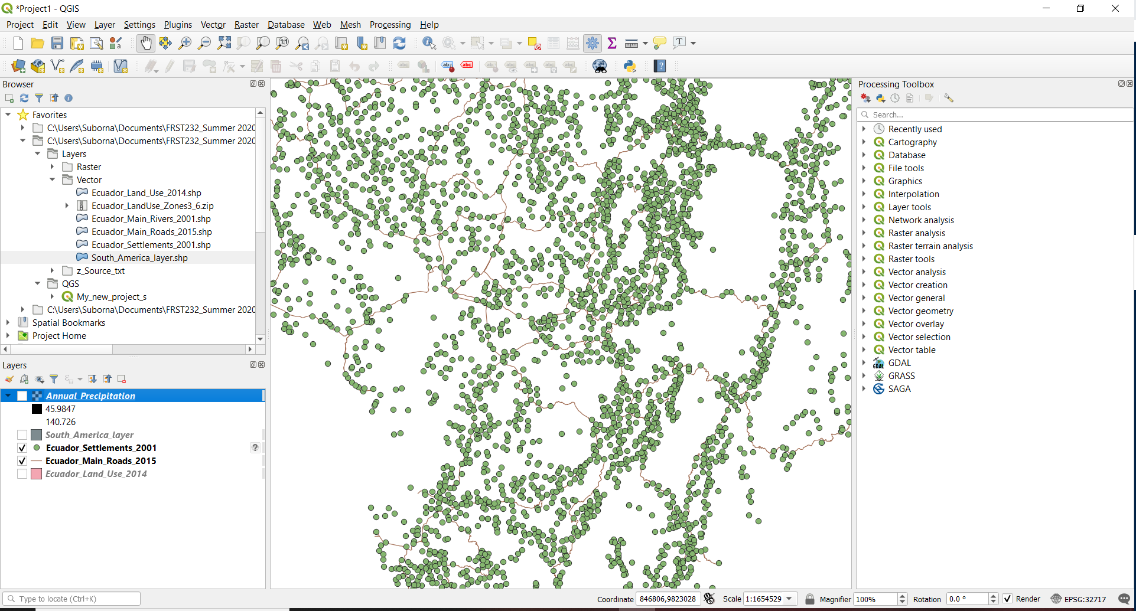
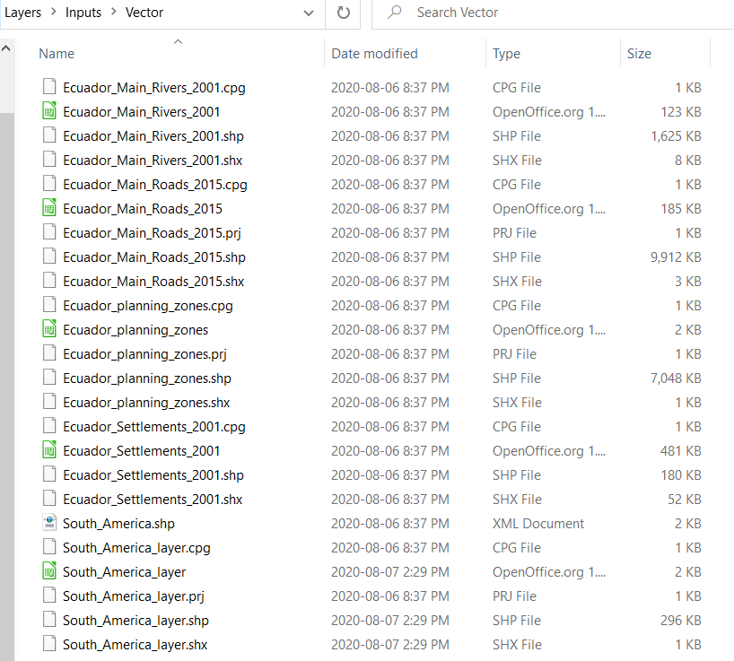
Vector Layers

Slide 21
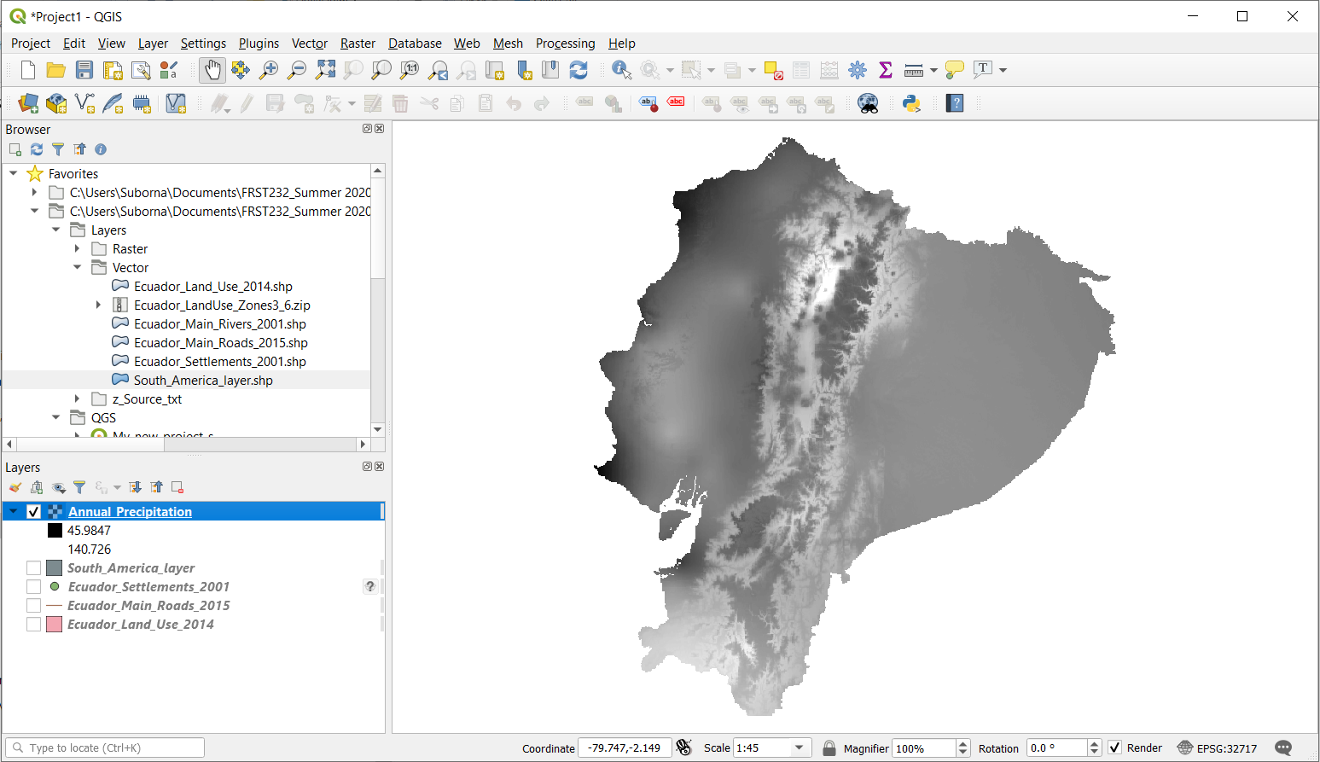
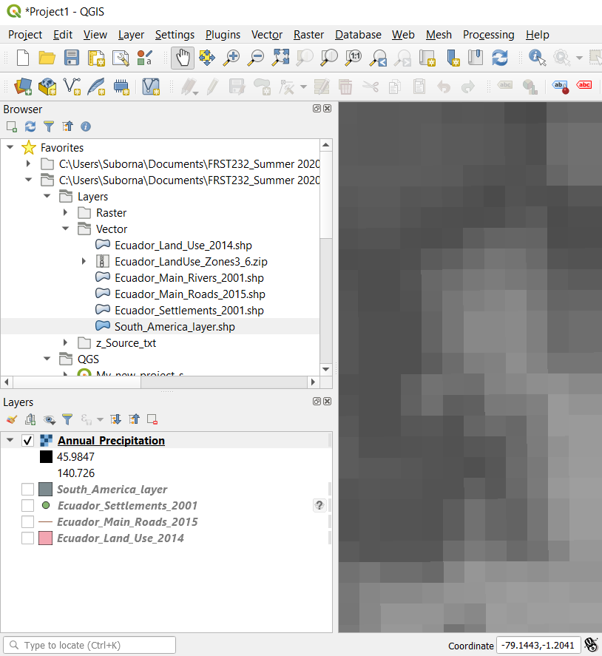
Raster Data

Slide 22
Data Frame
Toolbox
Browser: directories
Map Area
Data Layers on the map
Coordinates

Slide 23
Toolbox
How you manipulate data
Has built in functions
Like Microsoft tool bar (Just different tools)
Anything that you can find in the tool bar can also be found in the drop down menus
Hovering your cursor over any of the icons will tell you what it is
This does not mean it will tell you what it does

Slide 24
What makes a good map?
Image from: http://www.crwr.utexas.edu/gis/gishydro00/ArcGIS/Chapter10/maptemp.jpg
Notes:
On texas

Slide 25
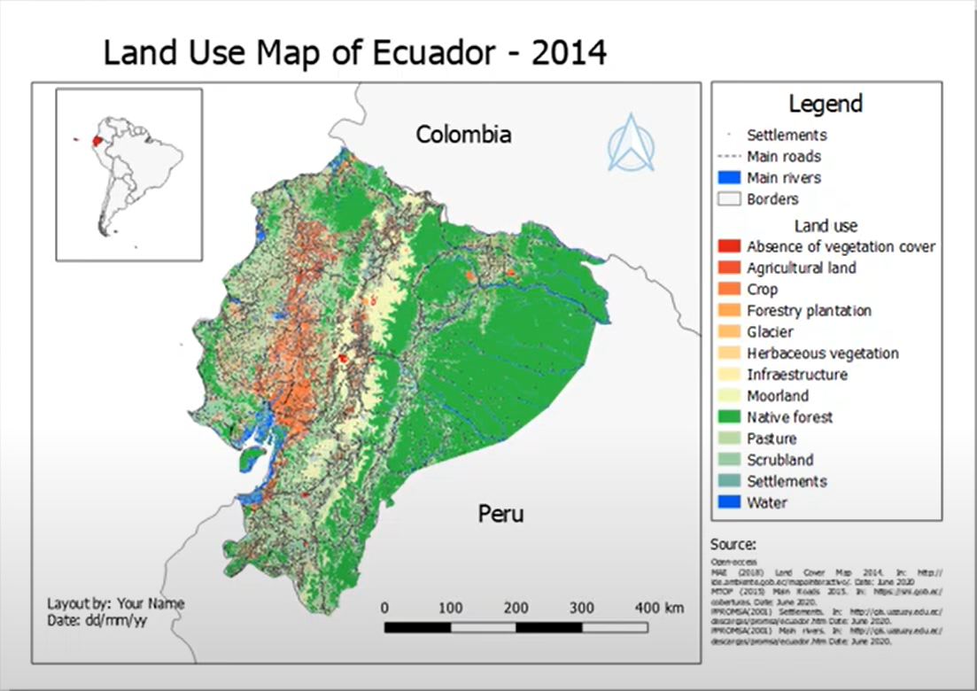
Notes:
http://fwf.punjab.gov.pk/sites/fwf.punjab.gov.pk/

Slide 26
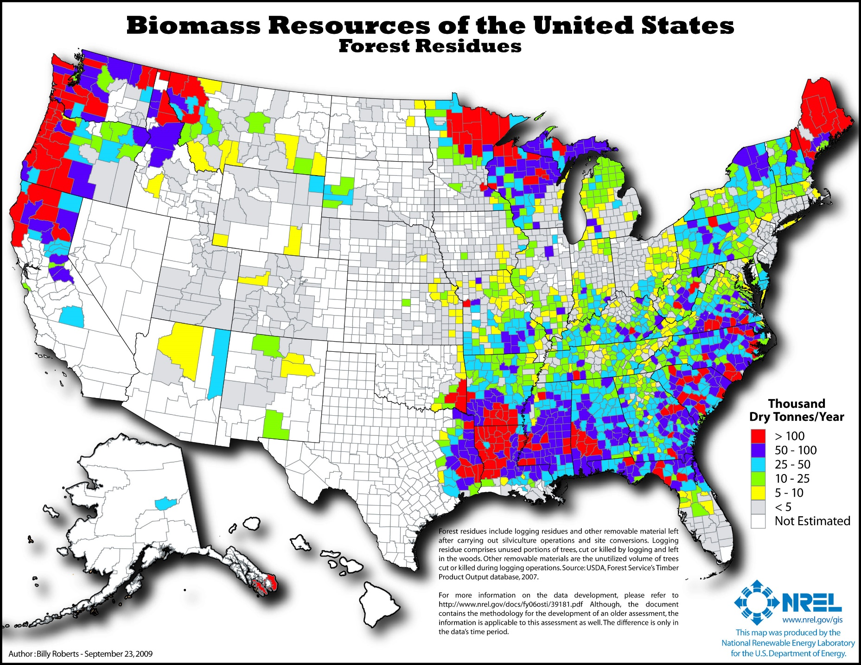
Image from: http://www.nrel.gov/gis/images/map_biomass_forest_residues.jpg
Notes:
, biomass has a broad geographic distribution, in some cases offering a least-cost and near-term alternative. The objective of this research is to estimate the biomass resources available in the United States and map the results.

