Slide 1
FRST 232
Computer Applications in Forestry
Map Elements

Slide 2
GIS MAP
Most common use of GIS is to present data/analysis in a map
Map types:
    Category map
    Quantity map
Map Elements

Slide 3
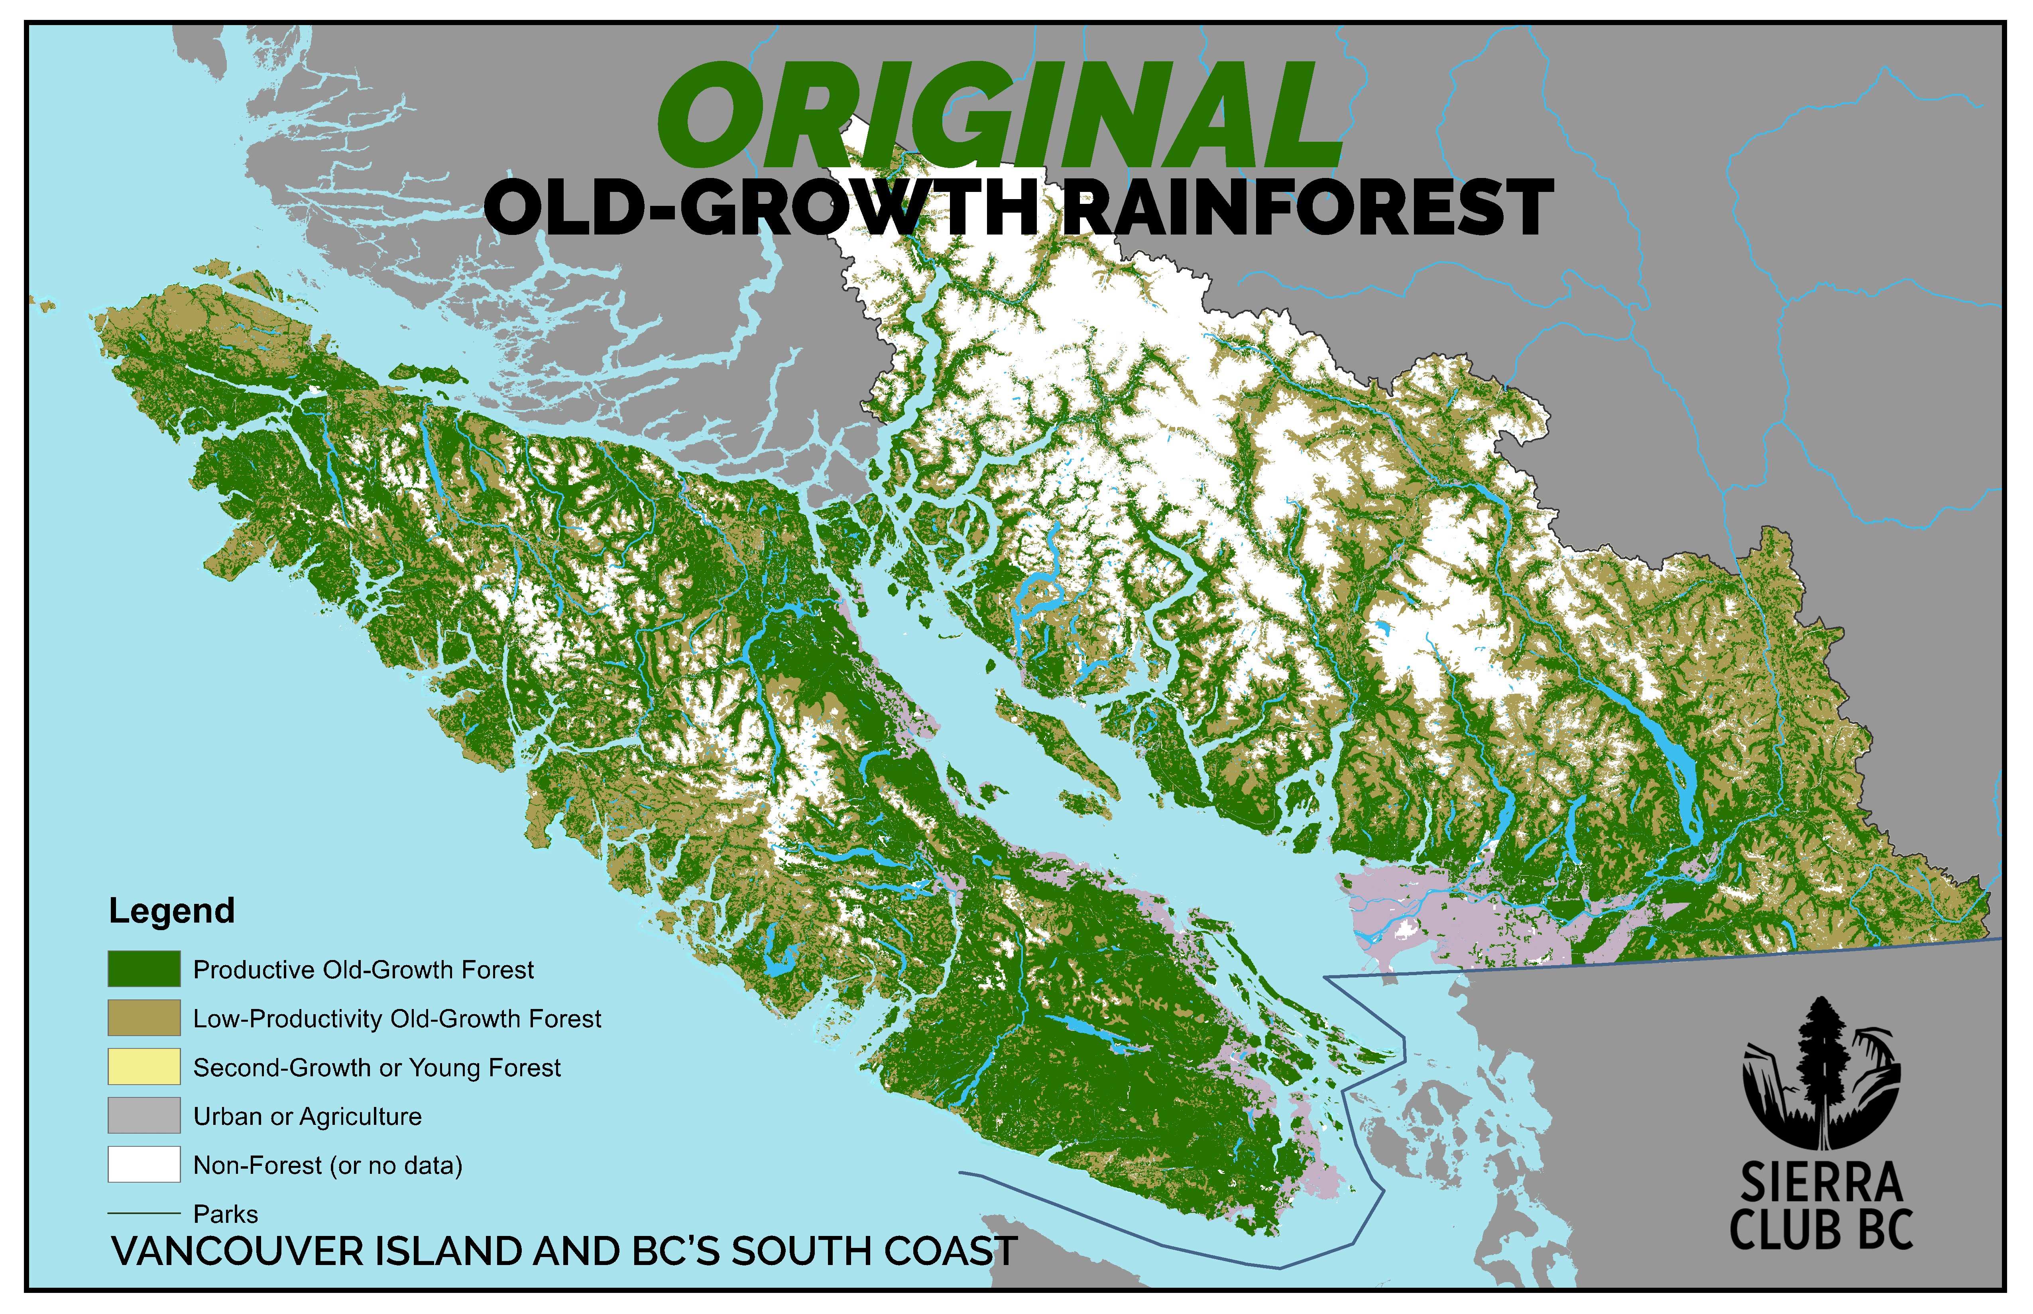
Category Map
http://sierraclub.bc.ca/growing-support-protecting-old-growth/

Slide 4
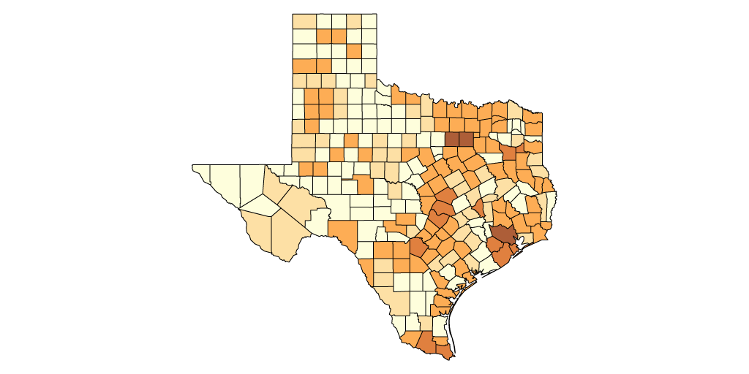
Quantity map
Each feature in the map is color coded based on sales. The darker color indicates more sales and lighter colors represent fewer sales.
https://mangomap.com/gis-mapping

Slide 5
MAP Elements
North arrows
Scale bars
Legends
Frames
Converting map elements to graphics

Slide 6
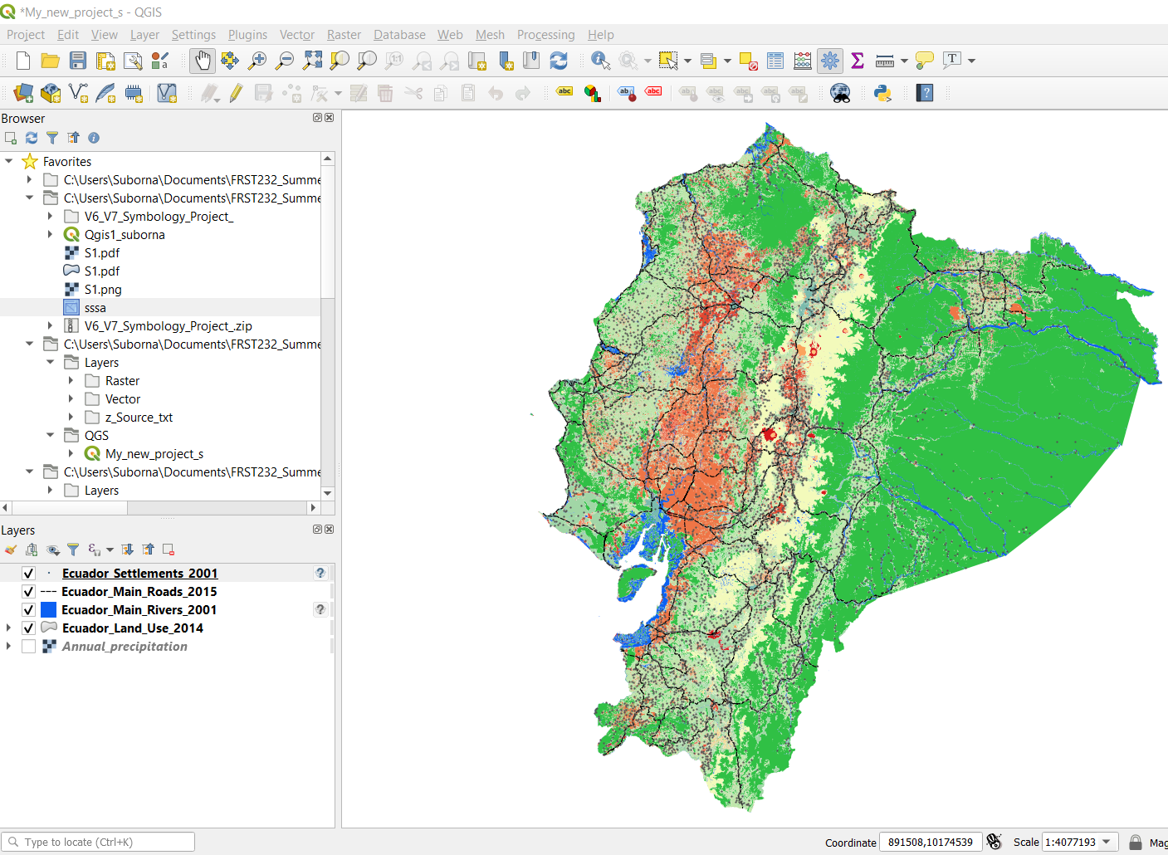
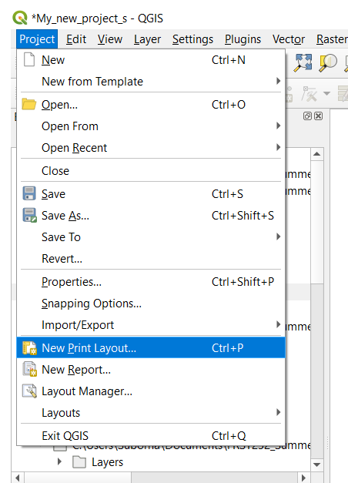
MAP View
QGIS shows maps in two different views:
  Data view and
  Print layout view
http://edndoc.esri.com/arcobjects/9.0/ComponentHelp/esriCarto/Carto_overview.htm

Slide 7
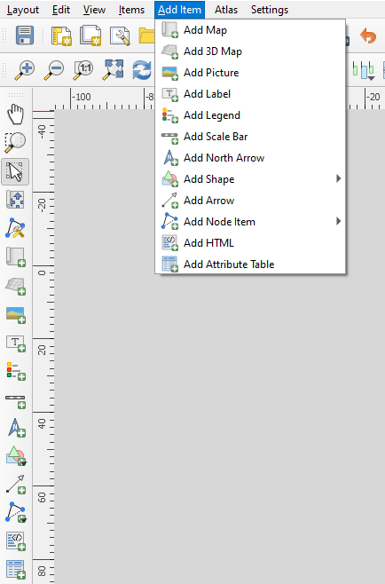
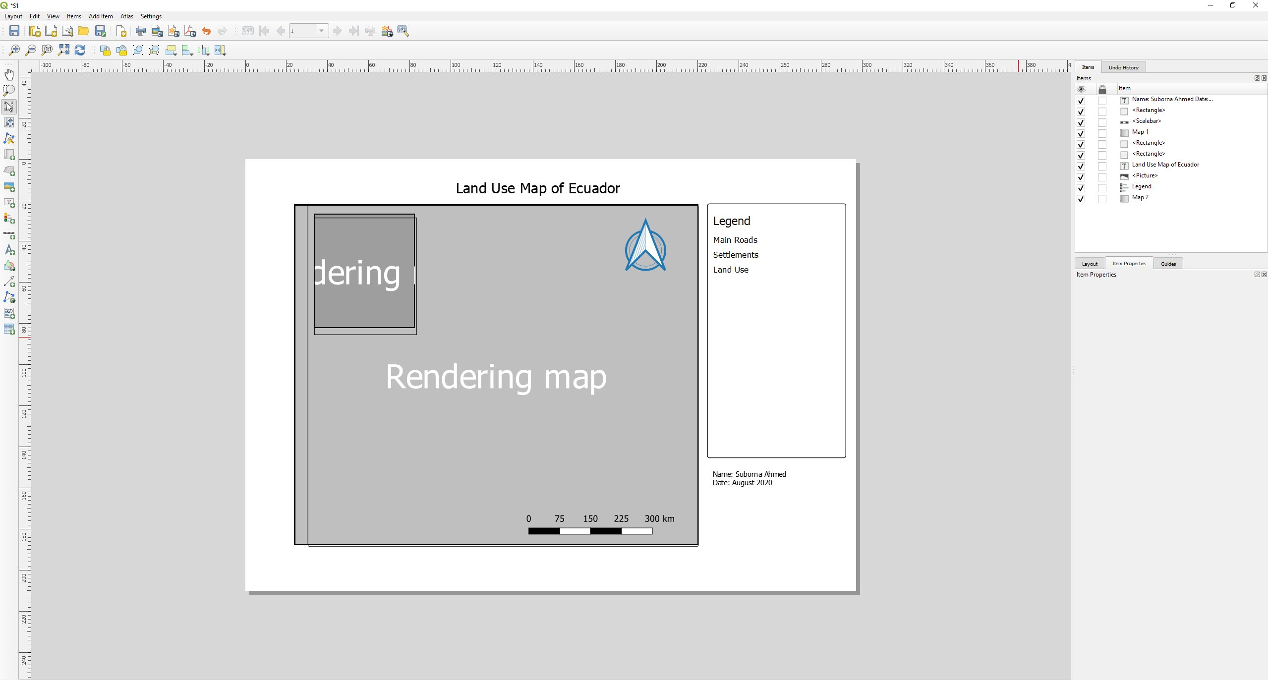
MAP Elements

Slide 8
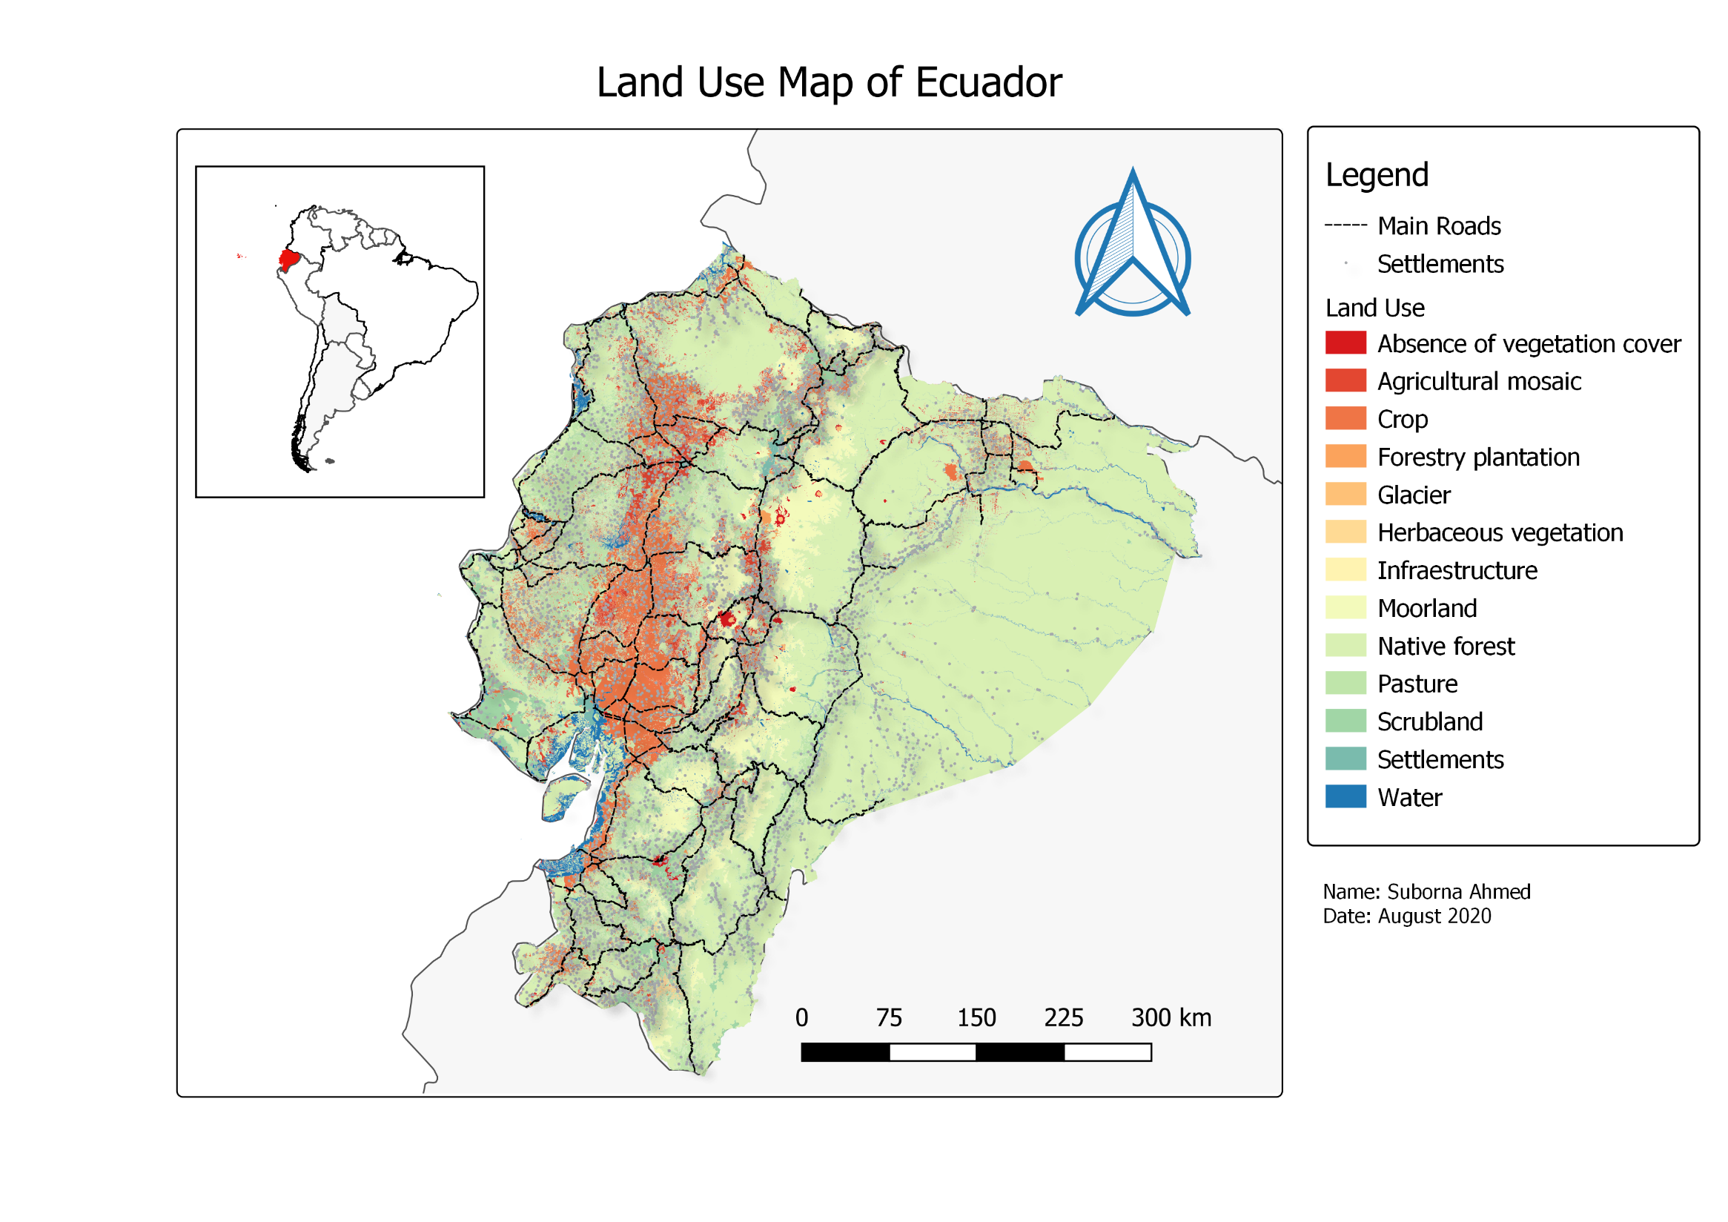
MAP Elements
North arrows
Scale bars
Legends
Frames

Slide 9
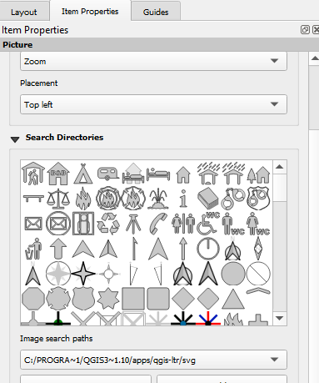
MAP Elements
North arrows
North arrows indicate the orientation of the map.
A north arrow element maintains a connection to a data frame..
North arrow properties include its style, size, color, and angle.

Slide 10
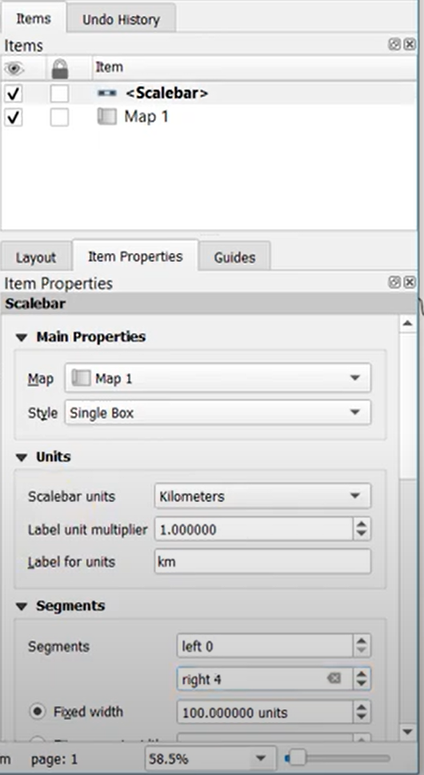
MAP Elements
Scale bars
Scale bars provide a visual indication of the size of features and distance between features on the map.
A scale bar is a line or bar divided into parts and labeled with its ground length, usually in multiples of map units such as tens of kilometers or hundreds of miles.
If the map is enlarged or reduced, the scale bar remains correct.
Notes:
Scale bars provide a visual indication of the size of features and distance between features on the map. A scale bar is a line or bar divided into parts and labeled with its ground length, usually in multiples of map units such as tens of kilometers or hundreds of miles. If the map is enlarged or reduced, the scale bar remains correct.
When you insert a new scale bar onto a map, this defaults to the Display Units specified on the General tab on the Data Frame Properties dialog box.
When you add a scale bar to a map, the number and size of the divisions might not be exactly as you want them. For example, you might want to show four divisions rather than three or show 100 meters per division instead of 200. You might also want to change the units that the scale bar shows or adjust how those units are represented. You can adjust many characteristics of a scale bar from the Scale Bar Properties dialog box.
You can control the behavior of the scale bar when it is resized or when the map scale changes by selecting one of the following options:

Slide 11
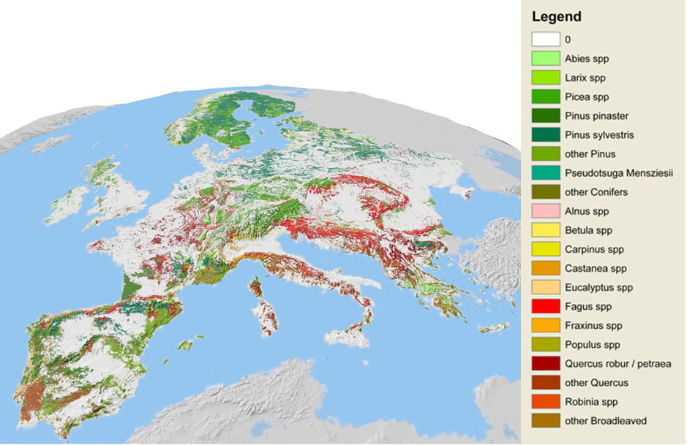
MAP Elements
Legend
Notes:
A legend tells a map reader the meaning of the symbols used to represent features on the map. Legends consist of examples of the symbols on the map with labels containing explanatory text. When you use a single symbol for the features in a layer, the layer is labeled with the layer's name in the legend. When you use multiple symbols to represent features in a single layer, the field you use to classify the features becomes a heading in the legend, and each category is labeled with its value.
Legends have patches that show examples of the map symbols. By default, the legend patches are points, straight lines, or rectangles that match the map symbols. You can customize the legend patches, for example, so areas are represented with patches of another shape, or rivers are drawn with a sinuous rather than a straight line.
If you have layers with transparency in your map, ArcMap simulates the transparent colors in your legend. When layers in a data frame are made transparent, the table of contents and the legends in layout view automatically use lighter colors to reflect transparency.
The option to simulate transparency in legends is set on the General tab on the Data Frame Properties dialog box. When this option is turned on, solid, bright red polygons drawn on a layer appear in the legend as a light red or pink, depending on the percentage of transparency applied to the layer. However, with the Simulate transparency option off, the legend still shows the solid red polygon symbol, even though the polygons don't appear red on the map because the layer is transparent.
By default, this setting is off (unchecked) for maps created with versions of ArcGIS prior to 9.3, but you can turn it on if you want. This setting is automatically checked on for new data frames you create in existing map documents.
In addition, you can convert the legend to graphics and manually specify the legend patch colors. Using the Eye Droppertool, you can obtain the exact RGB value of a pixel and use that color for the legend patch.
Frames

Slide 12
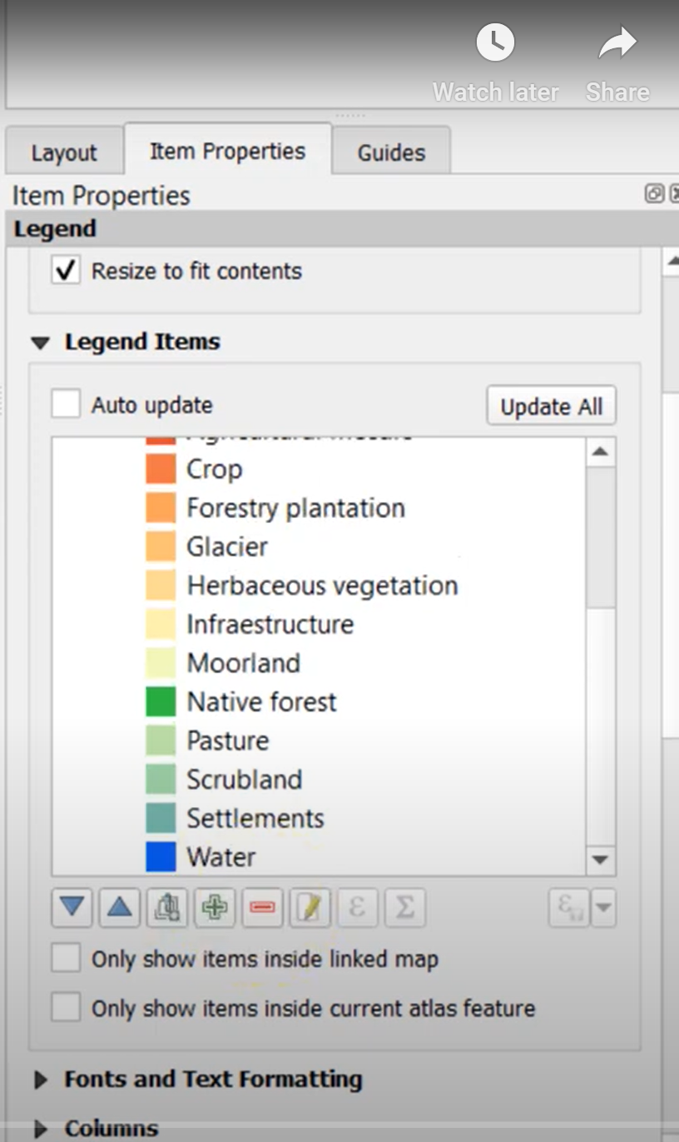
MAP Elements
Legend
Notes:
A legend tells a map reader the meaning of the symbols used to represent features on the map. Legends consist of examples of the symbols on the map with labels containing explanatory text. When you use a single symbol for the features in a layer, the layer is labeled with the layer's name in the legend. When you use multiple symbols to represent features in a single layer, the field you use to classify the features becomes a heading in the legend, and each category is labeled with its value.
Legends have patches that show examples of the map symbols. By default, the legend patches are points, straight lines, or rectangles that match the map symbols. You can customize the legend patches, for example, so areas are represented with patches of another shape, or rivers are drawn with a sinuous rather than a straight line.
If you have layers with transparency in your map, ArcMap simulates the transparent colors in your legend. When layers in a data frame are made transparent, the table of contents and the legends in layout view automatically use lighter colors to reflect transparency.
The option to simulate transparency in legends is set on the General tab on the Data Frame Properties dialog box. When this option is turned on, solid, bright red polygons drawn on a layer appear in the legend as a light red or pink, depending on the percentage of transparency applied to the layer. However, with the Simulate transparency option off, the legend still shows the solid red polygon symbol, even though the polygons don't appear red on the map because the layer is transparent.
By default, this setting is off (unchecked) for maps created with versions of ArcGIS prior to 9.3, but you can turn it on if you want. This setting is automatically checked on for new data frames you create in existing map documents.
In addition, you can convert the legend to graphics and manually specify the legend patch colors. Using the Eye Droppertool, you can obtain the exact RGB value of a pixel and use that color for the legend patch.
Frames

Slide 13
MAP Elements
Frames
Certain map elements—including scale bars, north arrows, legends, and data frames—can have frames.
Frames allow to choose a border, background for the element.
Can use frames to set map elements apart from other elements or from the background of the map.

Slide 14
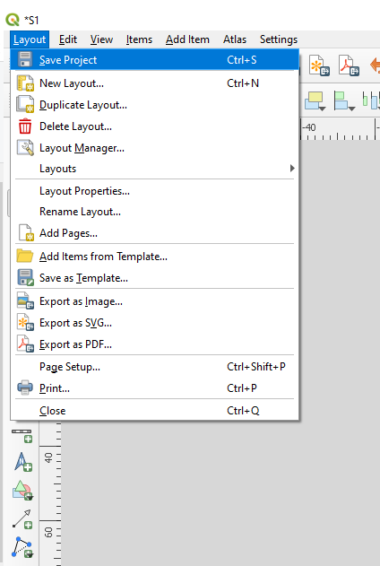
MAP Elements
Save your work

Slide 15
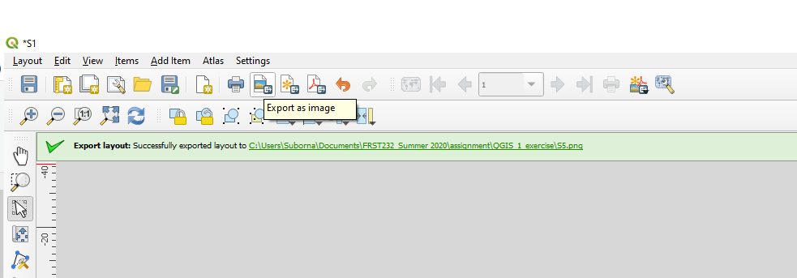
MAP Elements
Converting map elements to graphics
It is important to note that once you convert a map element into a graphic, it is no longer connected to its original data and will not respond to changes made to the map.
For instance, with a legend element, if you decide to add another layer to the map after the legend has been converted to a graphic, the legend will not automatically update. It will have to be deleted and rebuilt again using the Legend Wizard.
It is a good idea to convert elements to graphics only after map's layers and symbology are finalized.

