Slide 1
FRST 232 Computer Applications in Forestry
Geoprocessing Tools

Slide 2
Learning Objectives
Concept of GIS
Different table relationships
Geoprocessing Tools
Dissolve
Buffer
Clip
Union
Intersection
Difference
Split

Slide 3
Relationships
Link two things together
Describe the associating between the two objects
Students
have
Programs
Students
take
classes

Slide 4
Cardinality
Defines the relationship between the entities
Four possible cases
1-to-1
1-to Many
Many-to-1
Many-to-Many

Slide 5
One-to-one
Student# | FirstName | LastName | GPA
00001 | Bob | Czaja | 3.45
00002 | Tom | Wilson | 2.6
00003 | Anna | Garcia | 4.0
00004 | Roberta | Mohr | 3.23
ProgramID
0001
0001
0003
0002
GIS attribute table
External Data (eg. Excel Spreadsheet)
ProgramID | Name | Faculty | Advisor
0001 | Conservation | Forestry | Scott Hinch
0002 | FRM | Forestry | John Nelson
0003 | Medieval Studies | History | Arlene Sindelar

Slide 6
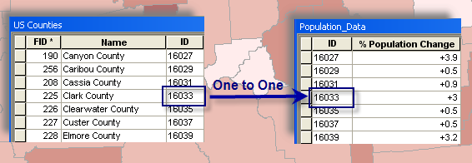
One-to-one
http://desktop.arcgis.com/en/arcmap/10.3/manage-data/tables/about-joining-and-relating-tables.htm
Notes:
When you join tables in ArcMap, you establish a one-to-one or many-to-one relationship between the layer's attribute table and the table containing the information you want to join. The example below illustrates a one-to-one relationship between each county and that county's population change data. In other words, there's one population change for each county.

Slide 7
Many-to-one
ProgramID | Name | Faculty
0001 | Conservation | Forestry
0002 | FRM | Forestry
0003 | Medieval Studies | History
0004 | Environmental Science | Sciences
0005 | Forest Operations | Forestry
Faculty | Faculty Dean
Forestry
History
Sciences
External Data
GIS attribute table

Slide 8
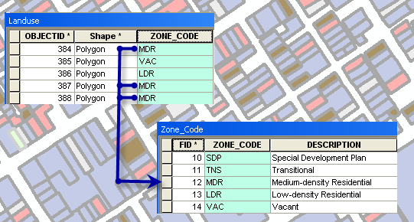
Many-to-one

Slide 9
One-to-many
ProgramID | Name | Faculty
0001 | Conservation | Forestry
0002 | FRM | Forestry
0003 | Medieval Studies | History
0004 | Environmental Science | Sciences
0005 | Forest Operations | Forestry
Faculty | Faculty Dean
Forestry
History
Sciences
GIS attribute table
External Data

Slide 10
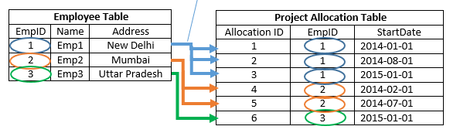
One-to-many
http://www.sqlrelease.com/sql-server-tutorial/table-relationships

Slide 11
Many to many
Student# | FirstName | LastName | GPA
00001 | Bob | Czaja | 3.45
00002 | Tom | Wilson | 2.6
00003 | Anna | Garcia | 4.0
00004 | Roberta | Mohr | 3.23
Student# | CourseID
00001 | 00002
00001 | 00003
00002 | 00001
00002 | 00003
CourseID | SubCode | Course# | Name | Description
00001 | CONS | 330 | Conservation Biology | Fundamental concepts in conservation biology…
00002 | CONS | 340 | Introduction to GIS for Forestry and Conservation | Introduction to principles, practice and context of Geographic Information Systems (GIS) …
00003 | CONS | 481 | Conservation Planning and Wildland Recreation | Theory and tools needed for the selection and design of protected areas…

Slide 12
Join
Student# | FirstName | LastName | GPA
00001 | Bob | Czaja | 3.45
00002 | Tom | Wilson | 2.6
00003 | Anna | Garcia | 4.0
00004 | Roberta | Mohr | 3.23
ProgramID
0001
0001
0003
0002
Join creates a new table
Puts two tables together
Needs to have a shared identifier
ProgramID | Name | Faculty | Advisor
0001 | Conservation | Forestry | Scott Hinch
0002 | FRM | Forestry | John Nelson
0003 | Medieval Studies | History | Arlene Sindelar

Slide 13
Join
Student# | FirstName | LastName | GPA | ProgramID | Name | Faculty | Advisor
00001 | Bob | Czaja | 3.45 | 0001 | Conservation | Forestry | Scott Hinch
00002 | Tom | Wilson | 2.6 | 0001 | Conservation | Forestry | Scott Hinch
00003 | Anna | Garcia | 4.0 | 0003 | Medieval Studies | History | Arlene Sindelar
00004 | Roberta | Mohr | 3.23 | 0002 | FRM | Forestry | John Nelson

Slide 14
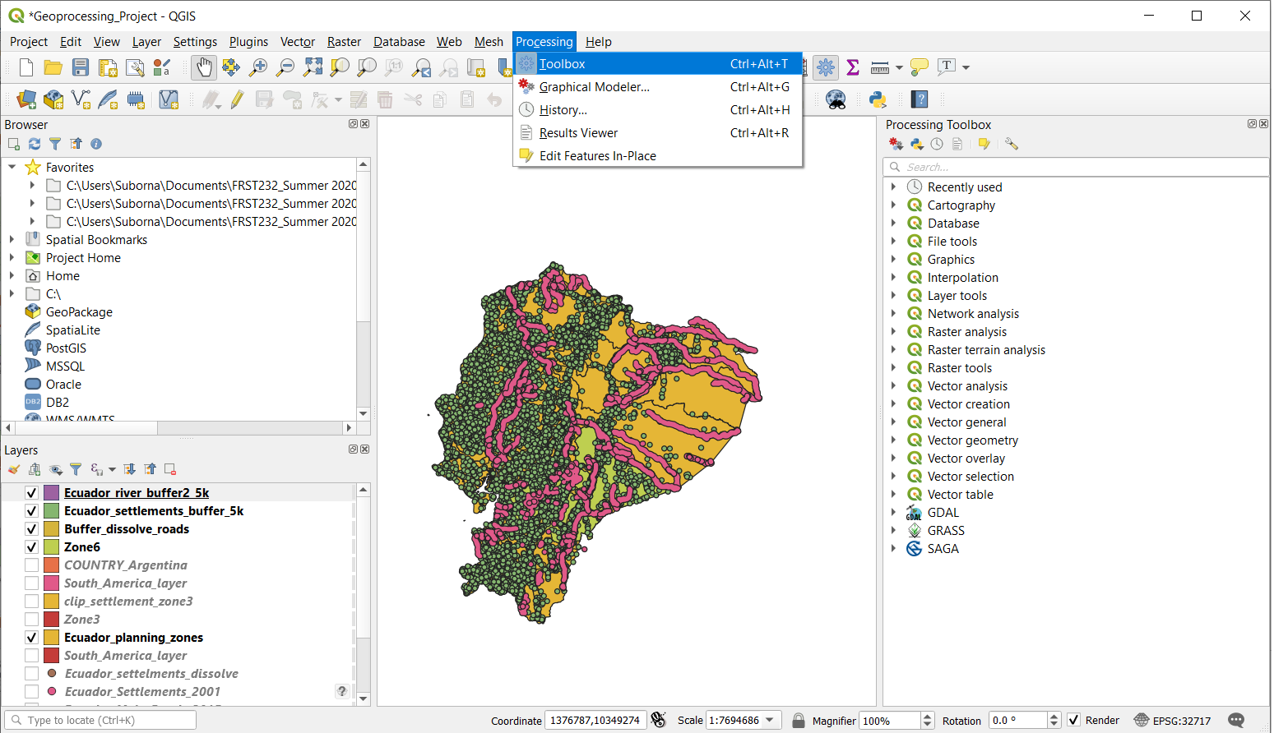
Geoprocessing Tool
http://pro.arcgis.com/en/pro-app/tool-reference/data-management/add-join.htm

Slide 15
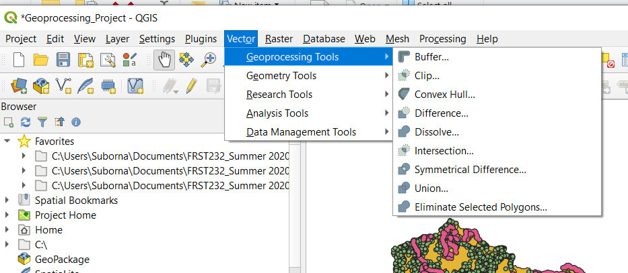
Geoprocessing Tool
http://pro.arcgis.com/en/pro-app/tool-reference/data-management/add-join.htm

Slide 16
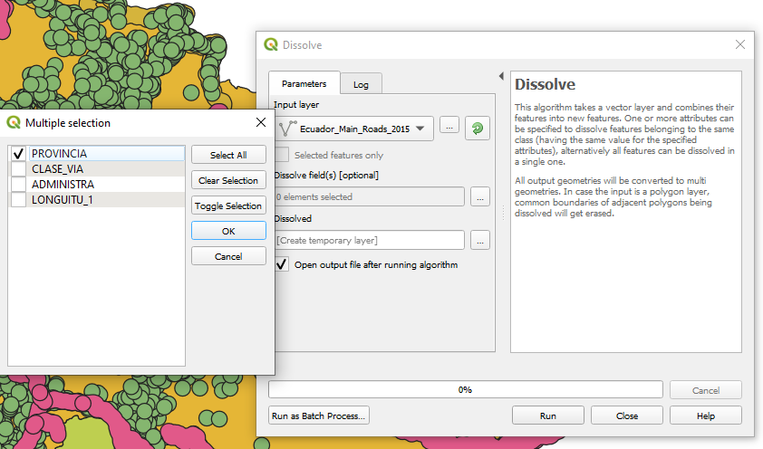
Dissolve
Dissolve aggregates features based on a specified attribute
Adjacent polygons with the same “code” are merged.

Slide 17
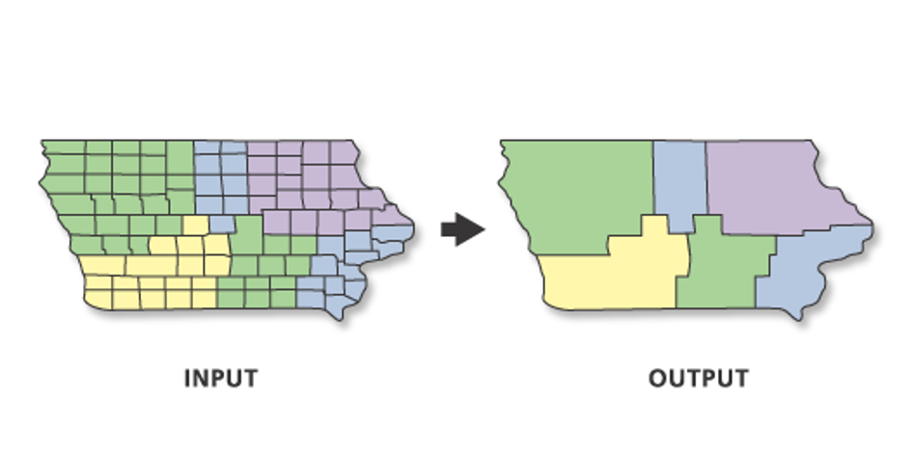
Dissolve

Slide 18
Buffers
Proximity Analysis where an area around a feature is created
Can create buffers of different of different sizes

Slide 19
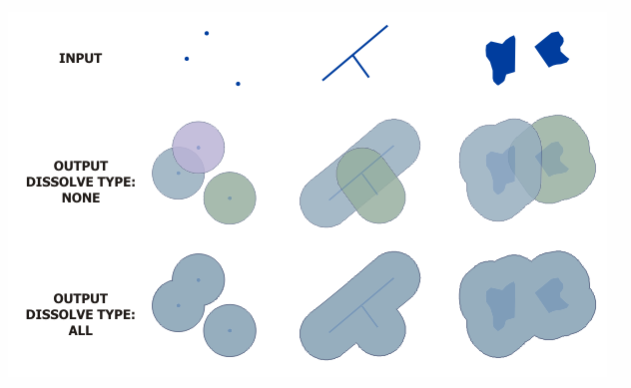
Buffers
http://desktop.arcgis.com/en/arcmap/10.3/tools/analysis-toolbox/buffer.htm

Slide 20
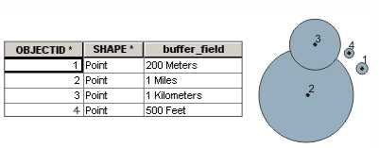
Buffers
A field from the Input Features is used to obtain buffer distances:
http://desktop.arcgis.com/en/arcmap/10.3/tools/analysis-toolbox/buffer.htm

Slide 21
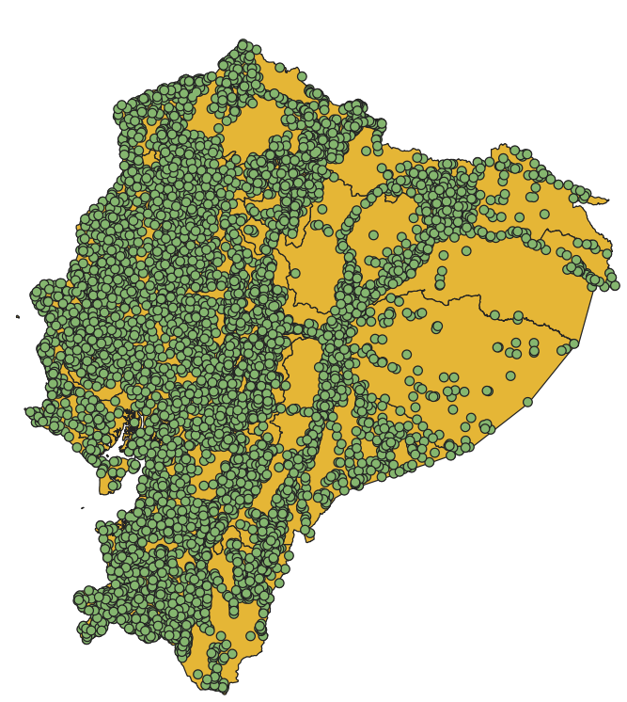
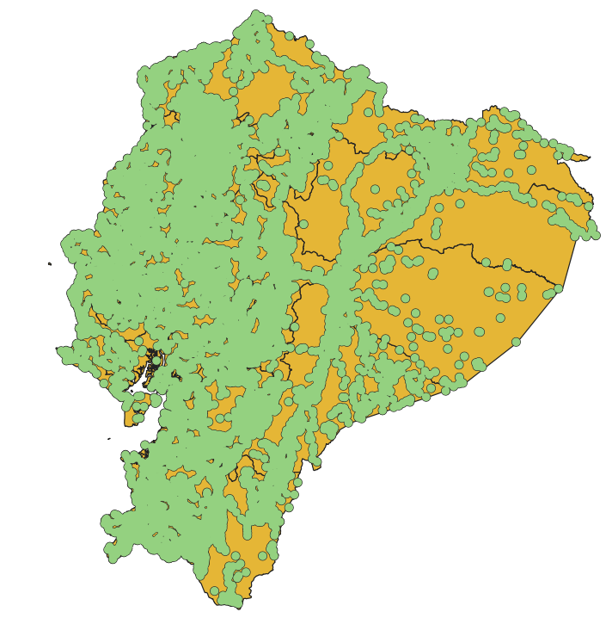
Buffer Polygons and Dissolve overlaps

Slide 22
Clip
Often we have access to a large master data set for your geographic region when the particular area that we are interested in is just a small portion of that region.
When you have a small study area, or are focusing on just a specific portion of a region, it's not really practical to bring in all of that extra data that lies outside of our area of interest. That's where the Clipping tool comes in.
By making a copy of only the data that falls within the study area and get rid of all the stuff that's outside, we can dramatically increase the efficiency of your map documents and make them render much more quickly.
Notes:
The Output Feature Class will contain all the attributes of the Input Features.
Attribute values from the input feature classes will be copied to the output feature class.

Slide 23
Clip
Use this tool to cut out a piece of one feature class using one or more of the features in another feature class as a cookie cutter.
This is particularly useful for creating a new feature class—also referred to as study area or area of interest (AOI)—that contains a geographic subset of the features in another, larger feature class.
http://pro.arcgis.com/en/pro-app/tool-reference/analysis/clip.htm

Slide 24
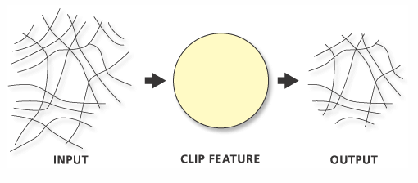
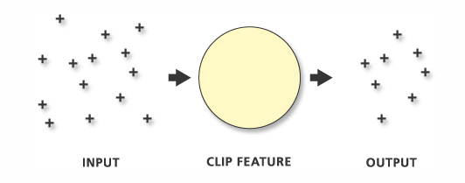
Clip
When the Input Features are polygons, the Clip Features must also be polygons.
When the Input Features are lines, the Clip Features can be lines or polygons.
When clipping line features with line features, only the coincident lines or line segments are written to the output.
When the Input Features are points, the Clip Features can be points, lines, or polygons.
http://pro.arcgis.com/en/pro-app/tool-reference/analysis/clip.htm

Slide 25
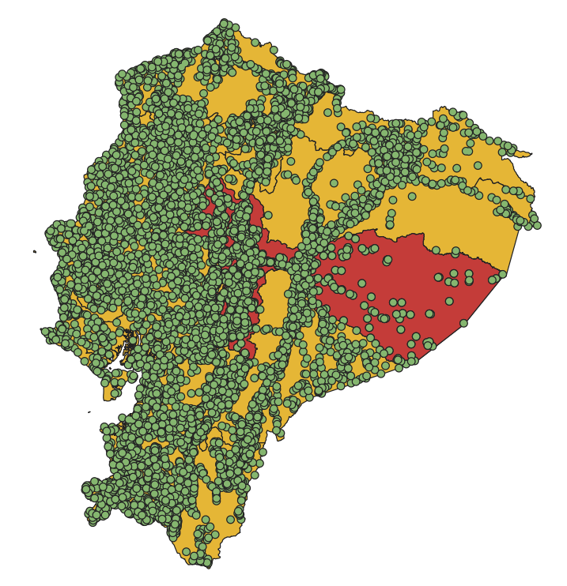
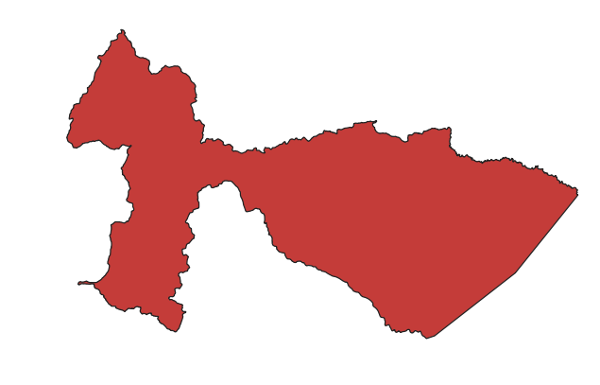
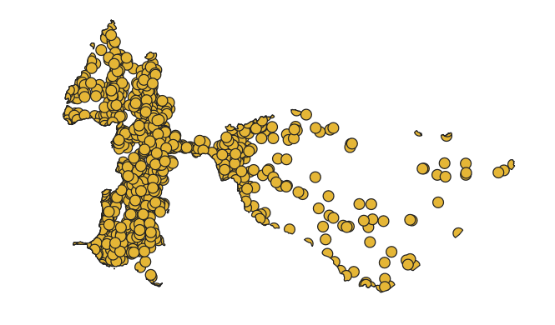
Clip
=
http://pro.arcgis.com/en/pro-app/tool-reference/analysis/clip.htm

Slide 26
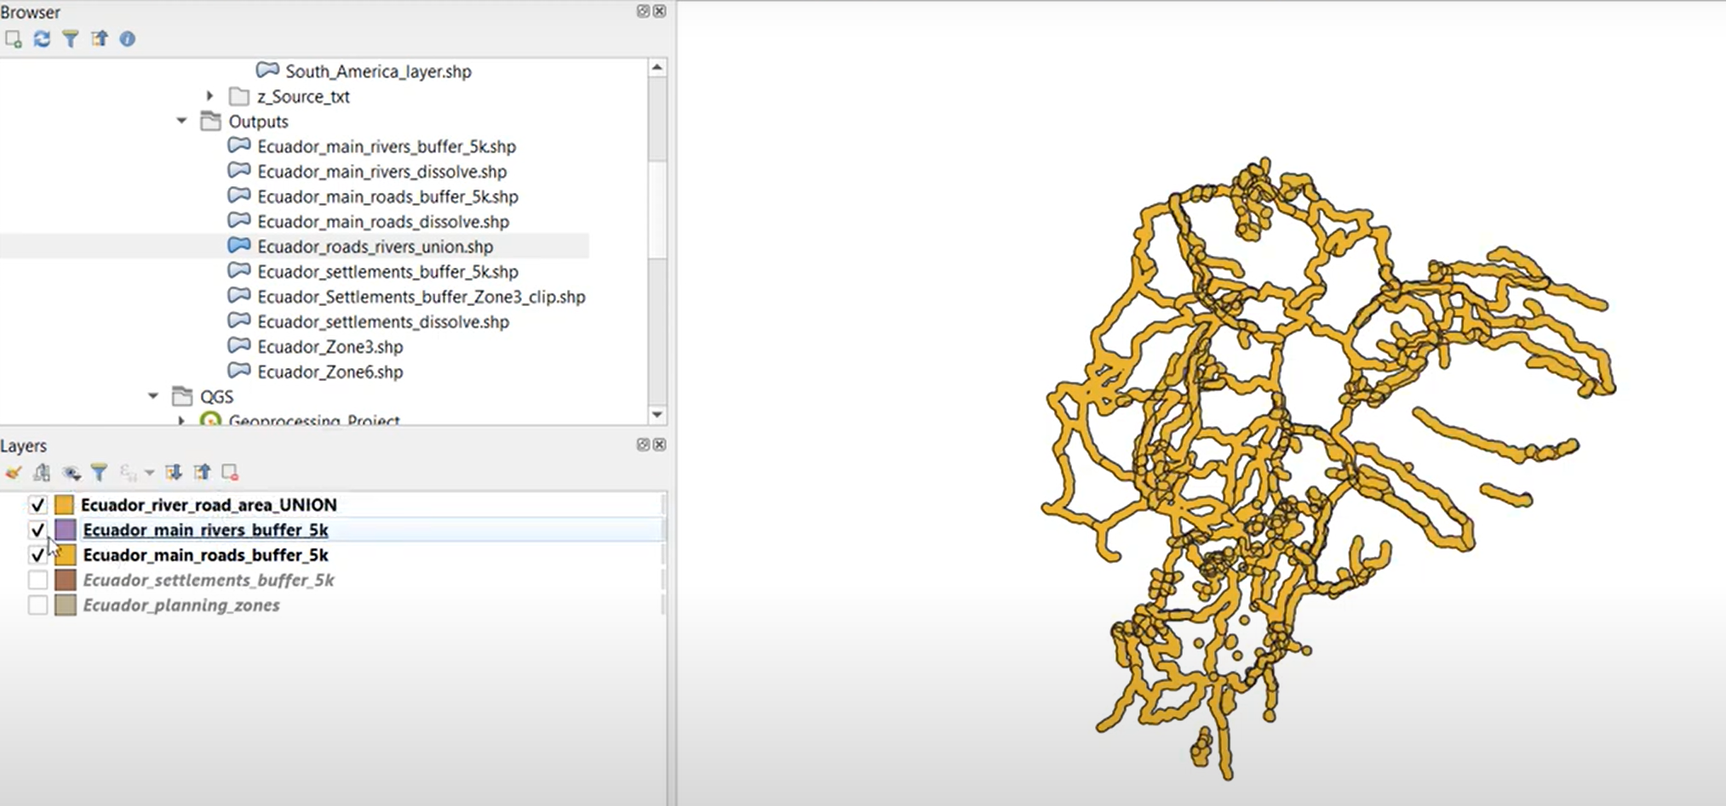
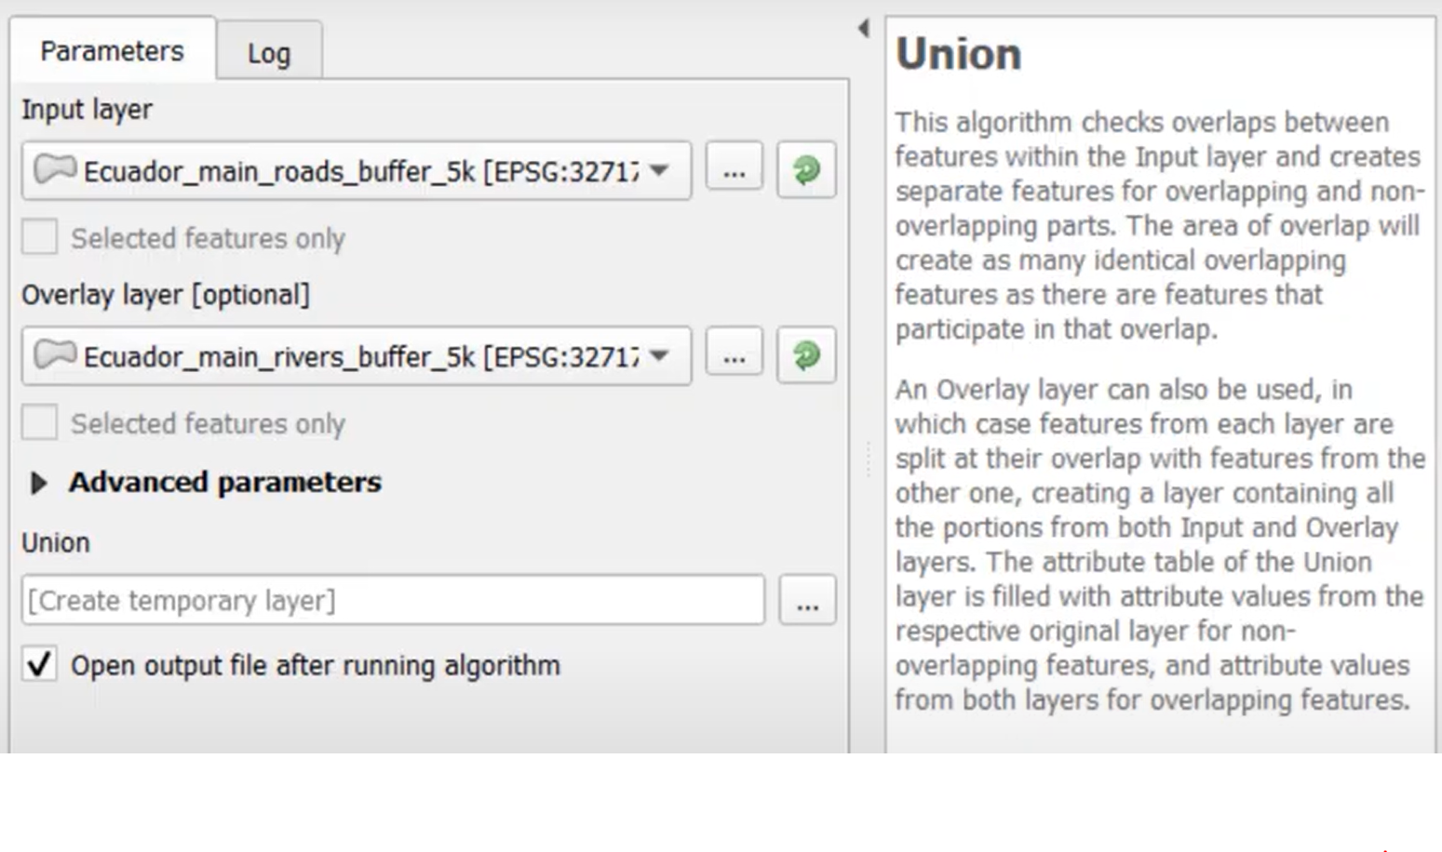
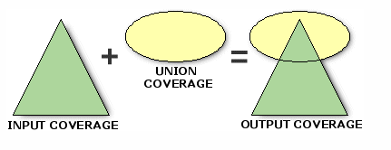
Union
Union tool merge layers into one layer and keep the boundary lines on both layers.

Slide 27
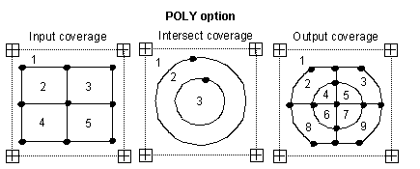
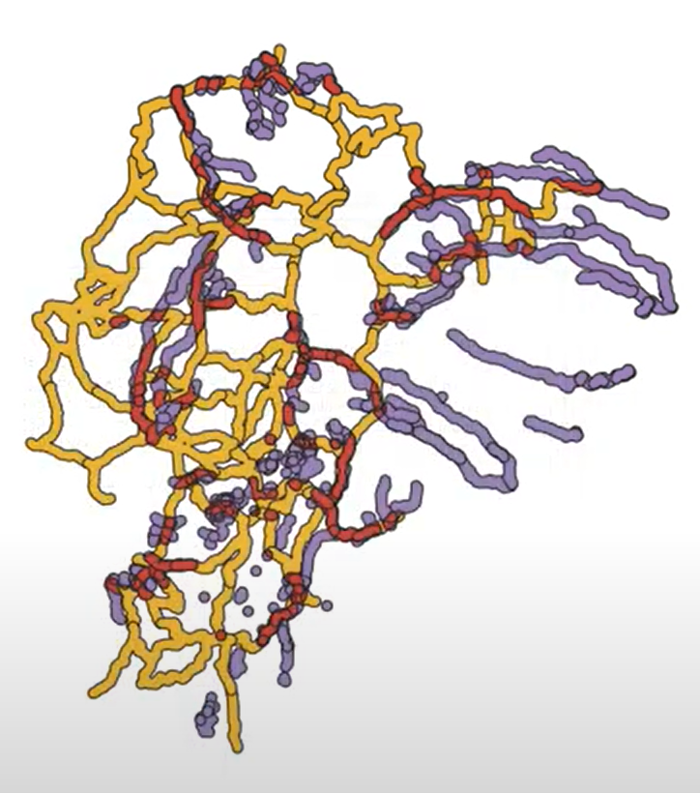
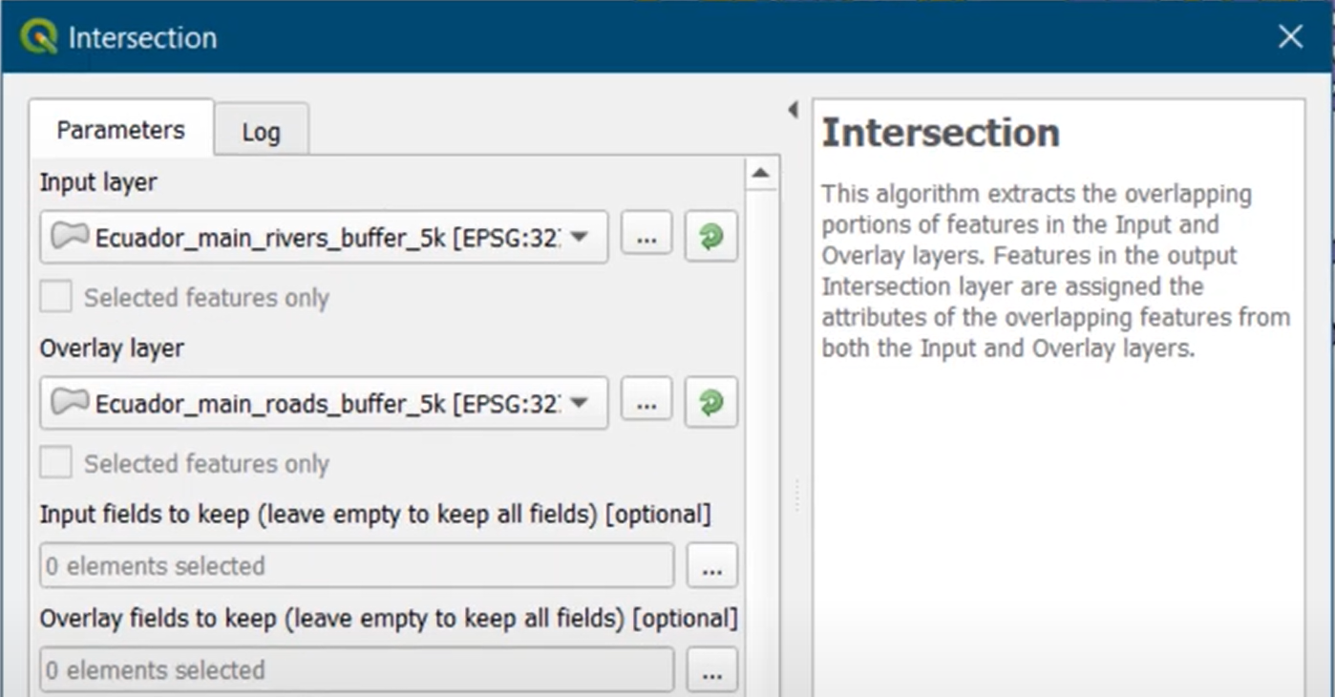
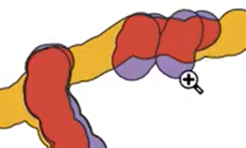
Intersect
Intersect tool exclude the non-overlapping areas.

Slide 28
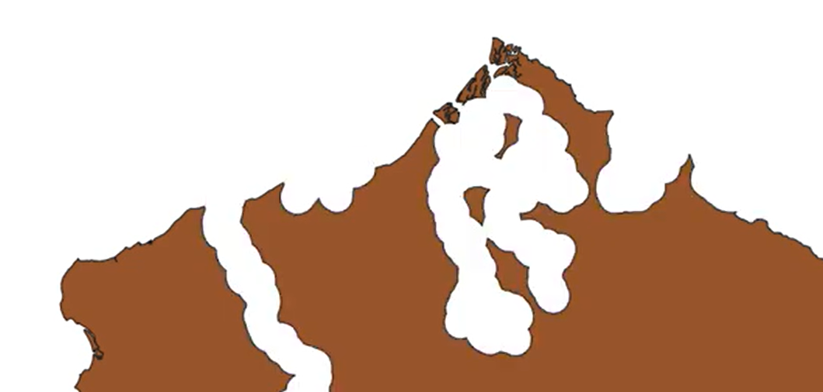
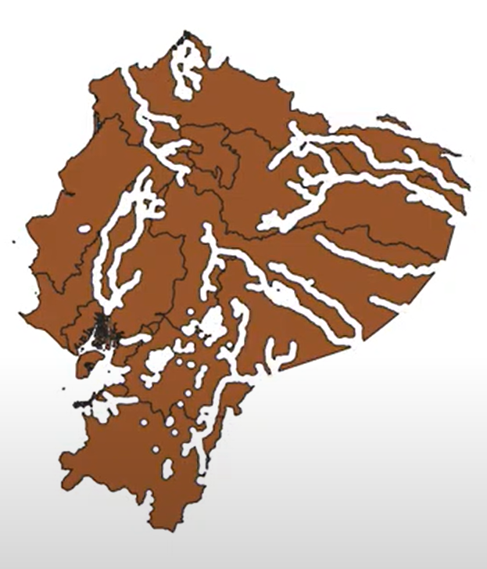
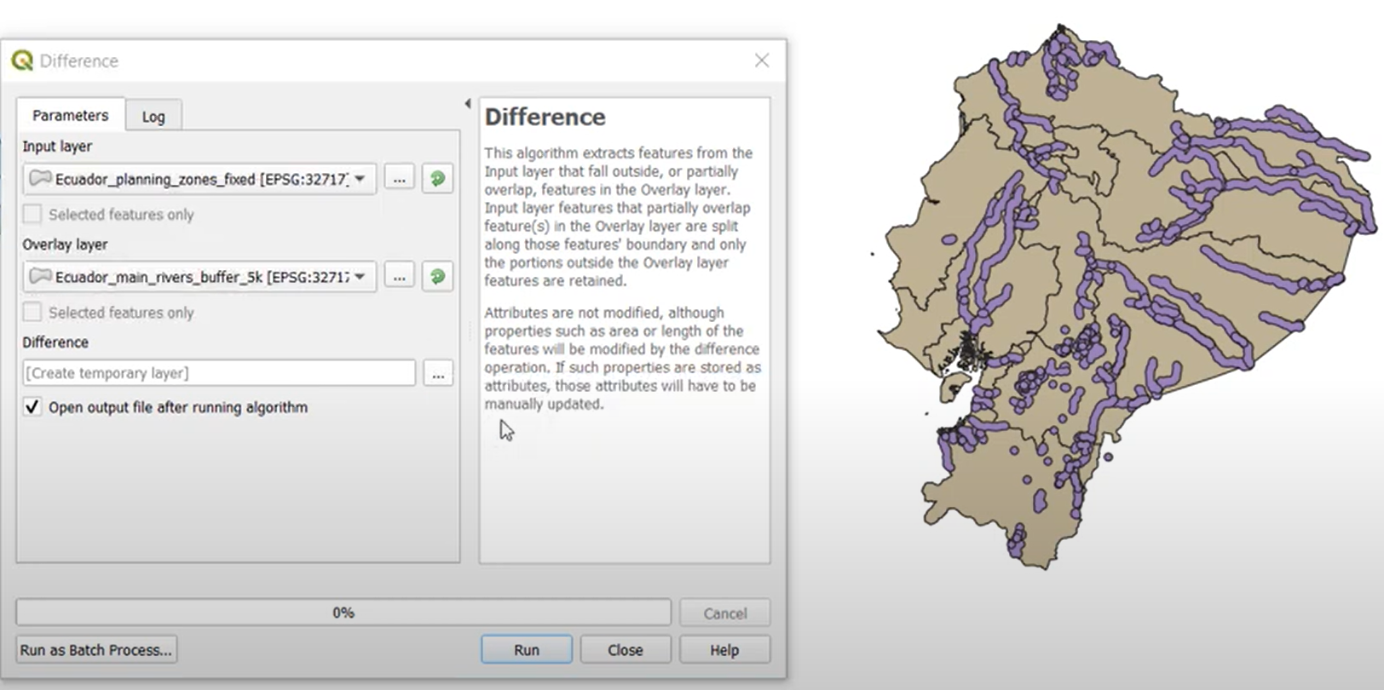
Difference
Difference is the opposite of the intersect tool. It removes the overlapping areas.

Slide 29
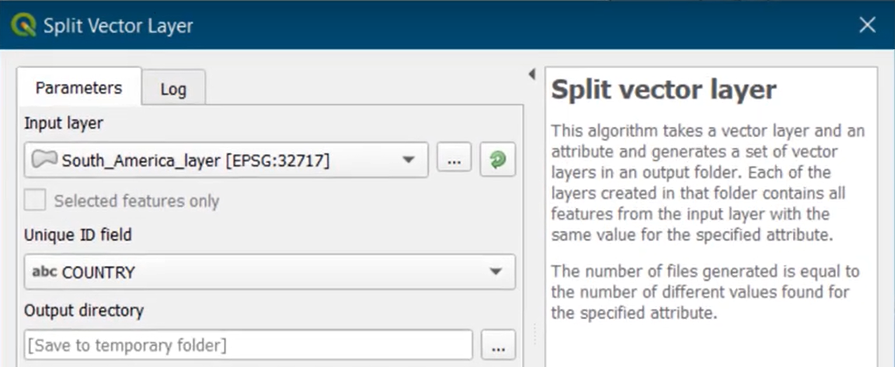
Split: Vector Layers
Clips portions of the input coverage into multiple coverages based on an attribute.
Each new output coverage contains only those portions of the input coverage features.
The number of output coverages is determined by the number of unique values in the attribute.

Slide 30
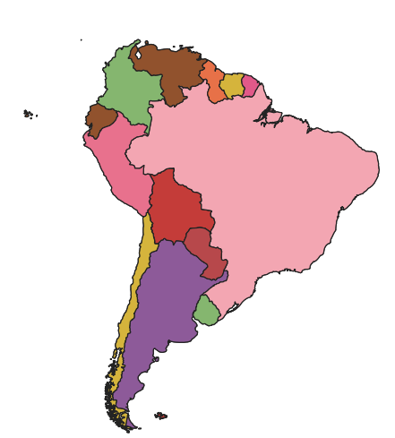
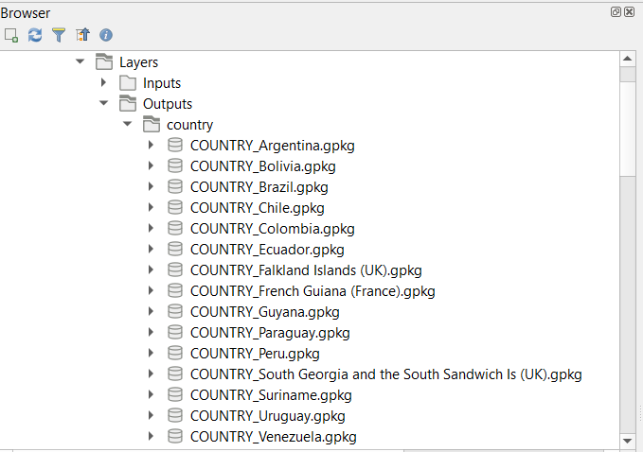
Split: Vector Layers

Slide 31
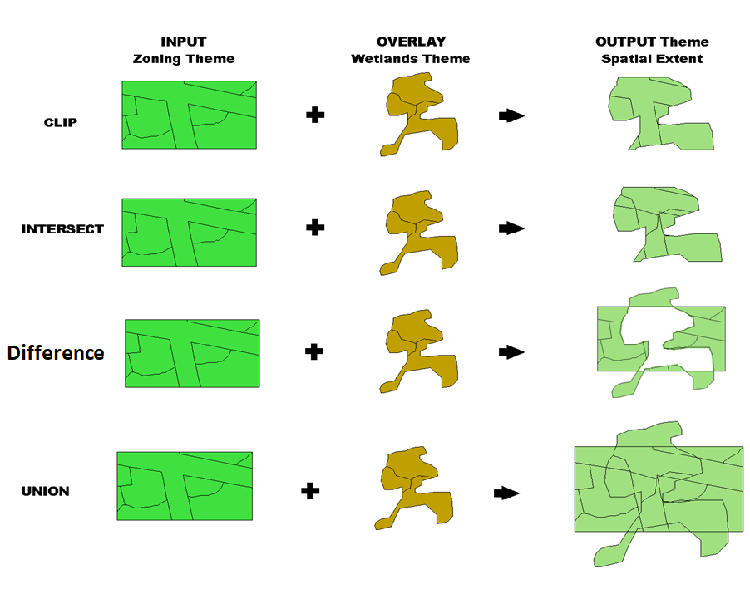
Overview

